Slide 1
Data Preparation
Tao

Slide 2
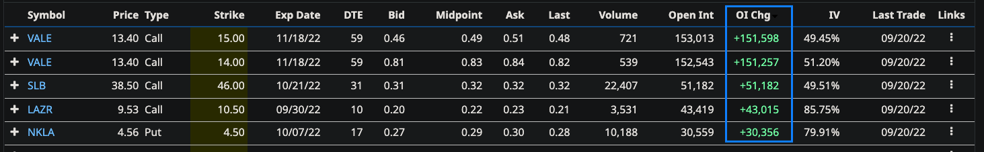
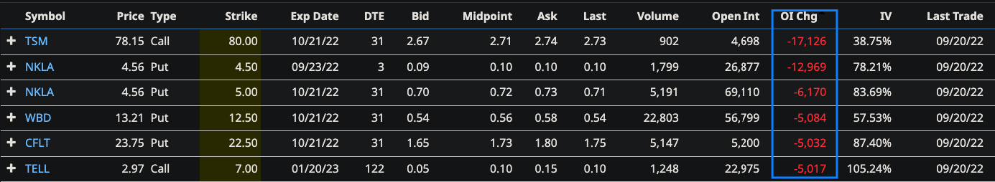
Data Source(Barchart)
Option open interest change (Increase)
Option open interest change (Decrease)

Slide 3
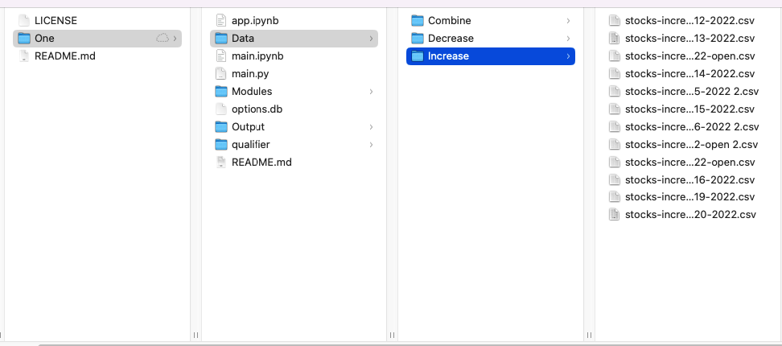
Data store location

Slide 4
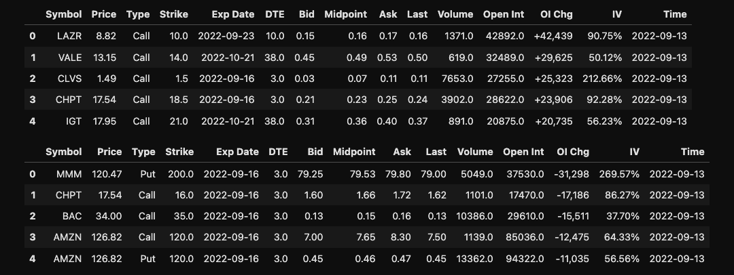
Read Data

Slide 5
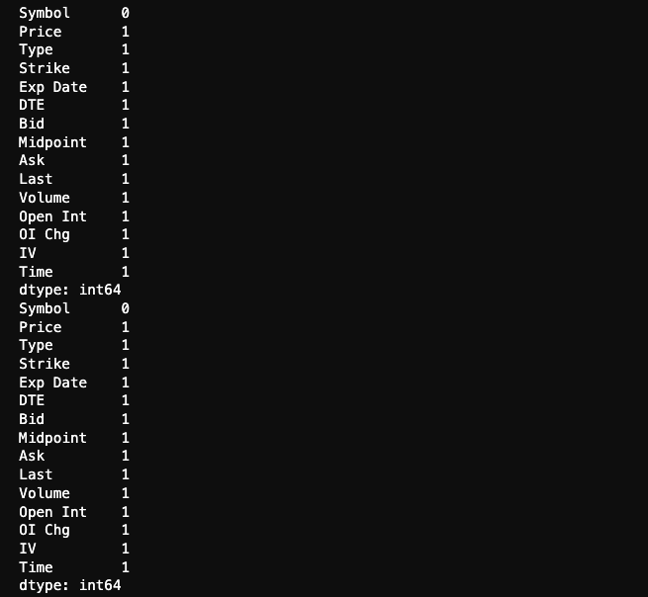
Check null & Drop data

Slide 6
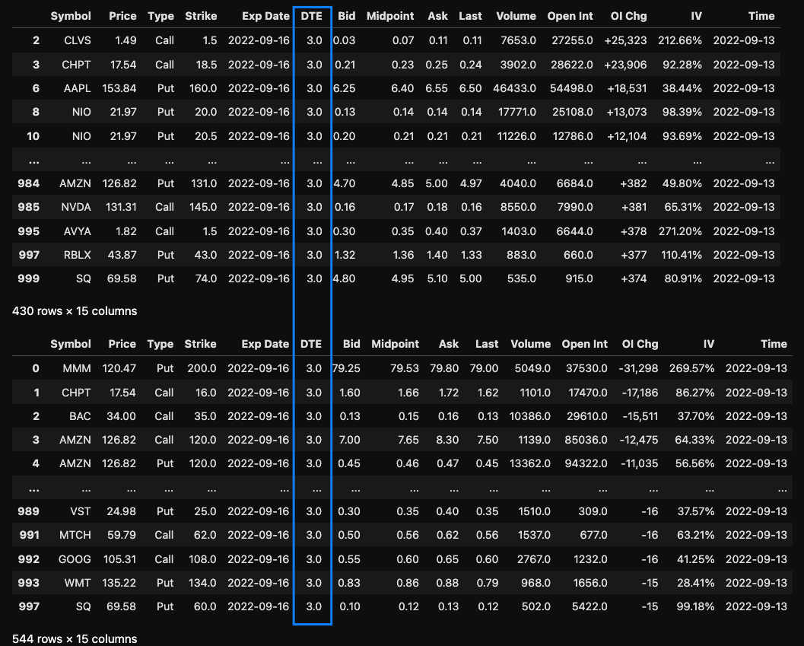
Select target Data

Slide 7
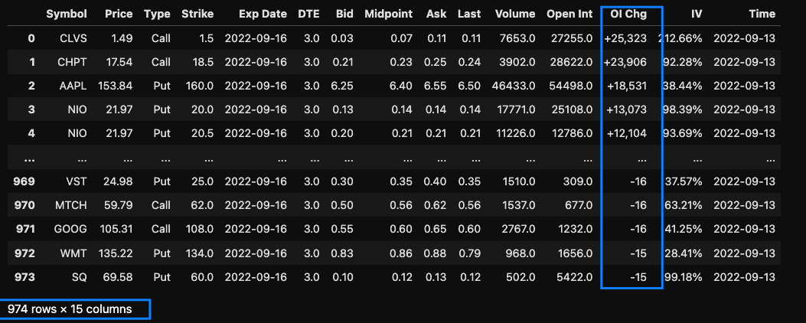
Combine Data

Slide 8
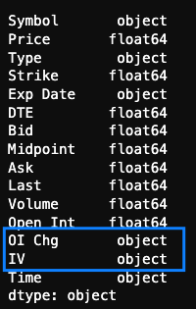
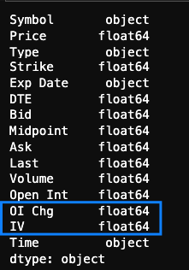
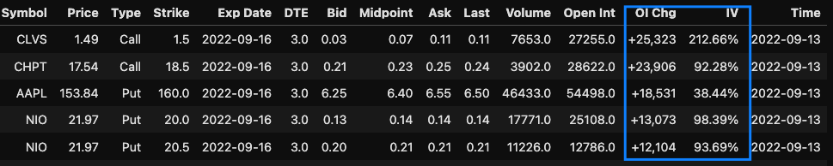
Correct data type

Slide 9
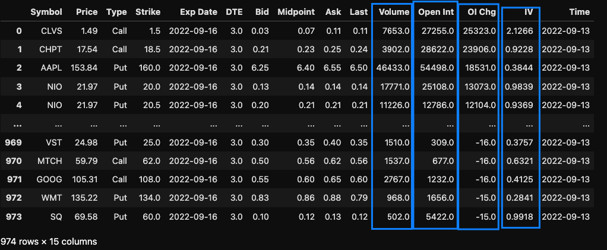
Sort data
Symbol –Type – Strike -Open Int – Volume - OI Chg –IV

Slide 10
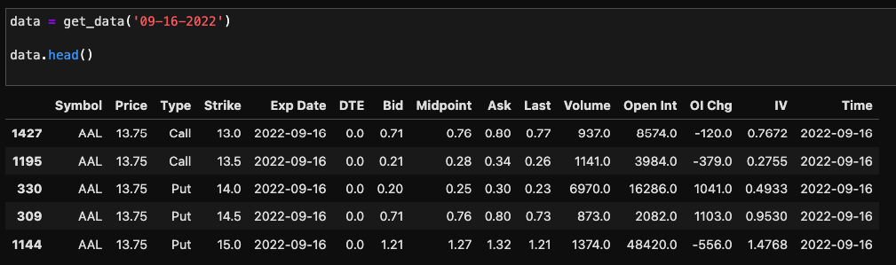
Create Module
Easy access data

